Slide 1
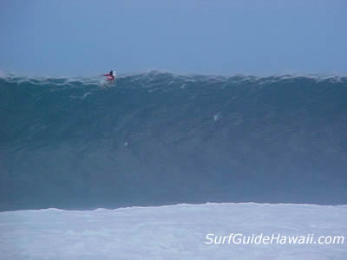
Waves (Chapter 10)

Slide 2
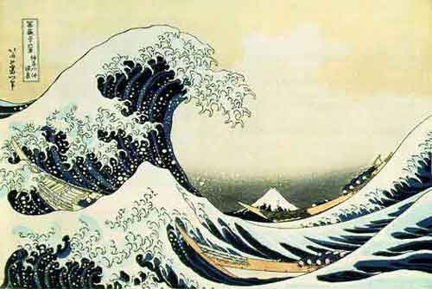
Anatomy of a wave…
A wave is the transmission of energy through matter. It transmits energy to adjacent matter, allowing the energy to continue.
Great Wave off of Kanagawa by Japanese artist Katsushika Hokusai
http://oceanworld.tamu.edu/students/waves/index.html

Slide 3
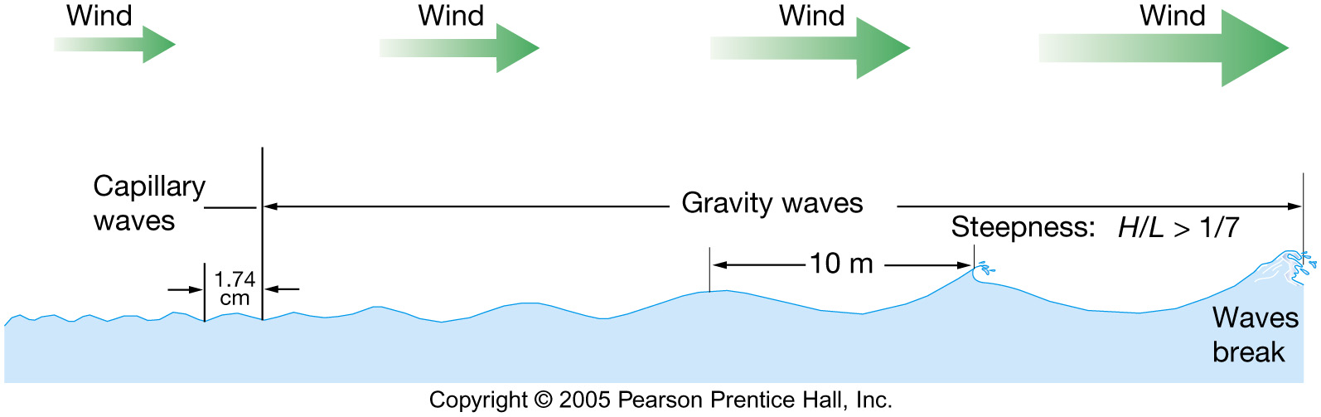
Waves
Caused by:
Wind
Earthquakes
Gravitational force of the Moon and Sun.

Slide 4
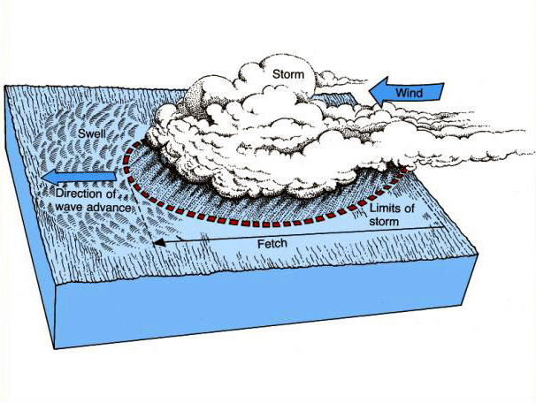
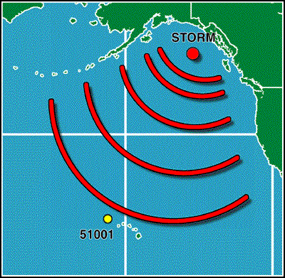
Waves
Sea = area where waves generated by storm
Swells - more regular waves, beyond area of generation form, and the progressive wave move across the ocean.
These waves may travel hundreds of miles across the ocean, only to break on some distant shore.

Slide 5
Parts of a Wave
Crest – highest point of a wave
Trough – lowest point of a wave
Wave Height – vertical distance between the crest and the trough
Wavelength – horizontal distance between two crests or two troughs

Slide 6
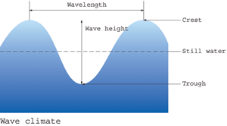
Wavelength
Crest
Wave Height
Still Water
Trough
Wave Parts
Deadliest Catch: The Physics of Waves : Video : Discovery Channel

Slide 7
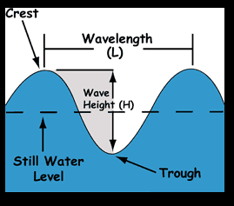
What are the parts of a wave?
    Crest (peak) – highest point above average water level.
    Trough – lowest point below average water level.
    Height – vertical measurement from trough to crest.
    Wavelength – horizontal distance between the identical point of two waves.

Slide 8
Waves Caused by Wind
When wind blows across a body of water, friction causes the water to move along with the wind.
Wave Height depends on –
  Wind speed
  Fetch: Distance over which the wind blows
  Length of time the wind blows

Slide 9
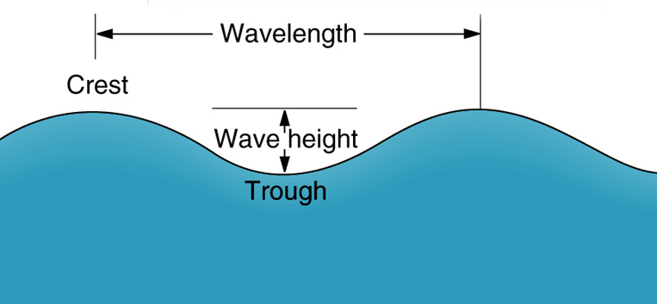
Wave Period - The time it takes one wave to pass a given point
Wave frequency - The number of waves that pass a given point in a given time
Waves may be progressive or standing
• Progressive waves move across the sea surface.
• Standing waves oscillate about a fixed point.

Slide 10
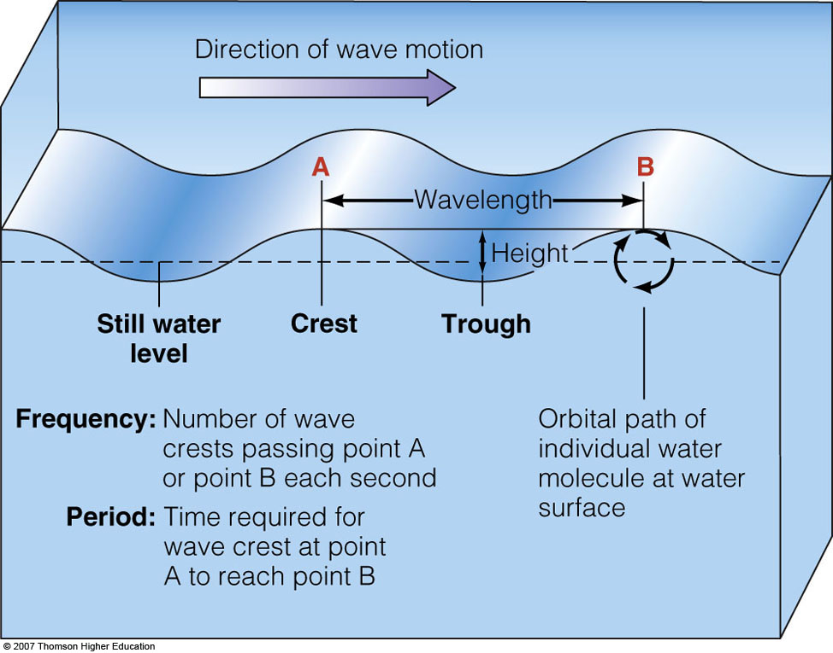
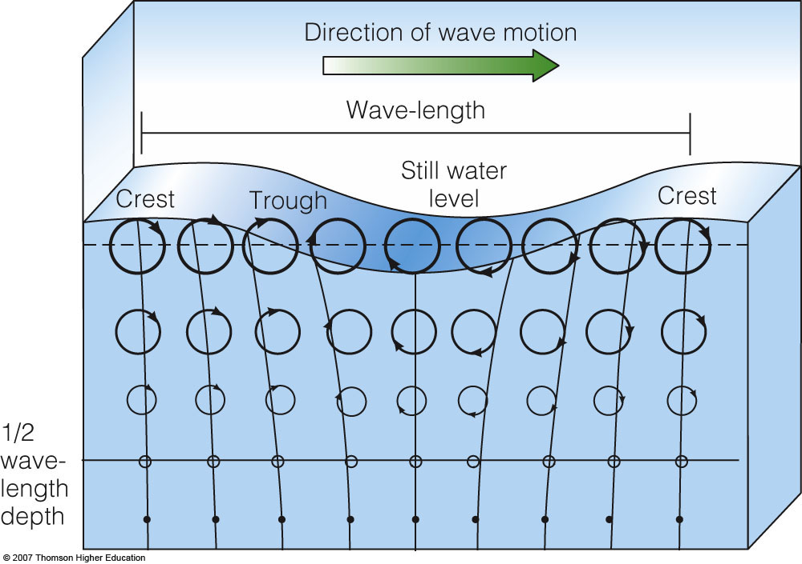
Ocean Waves Move Energy across the Sea Surface
(right) Progressive waves are waves of moving energy in which the wave form moves in one direction.
Orbital waves are a type of progressive wave because the waveform moves forward.
(left) Orbital waves are waves in which the particles of water move in closed circles as the wave passes.

Slide 11
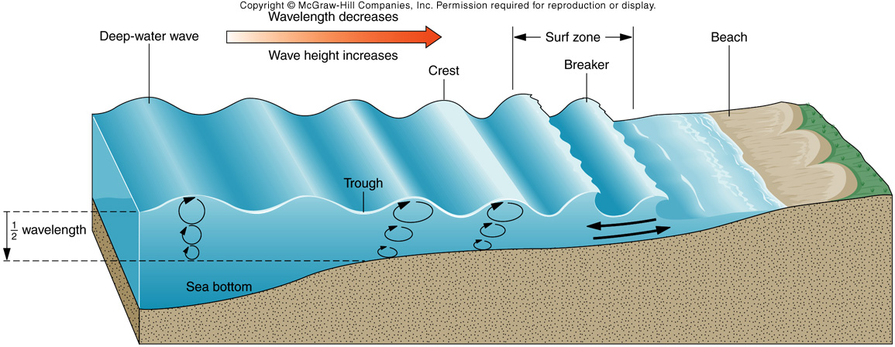
Wave Movement
When a wave passes through the ocean, individual water molecules move up and down but they do not move forward or backward.
Observe an animation of wave motion.

Slide 12
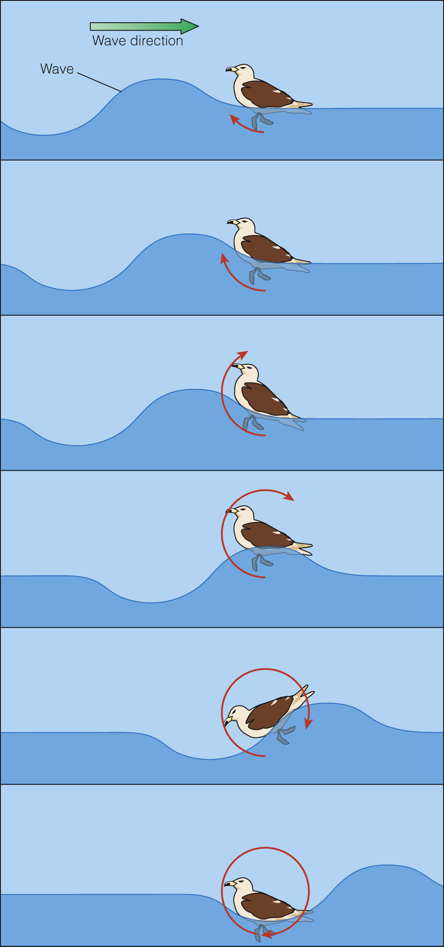
Wave Movement
Waves transmit energy
Particles in ocean waves move in orbital paths
  Particles may move
    Up and down
    Back and forth
    Around and around

Slide 13
NOAA’s “Ocean Waves”
http://oceanexplorer.noaa.gov/edu/learning/player/lesson09.html

Slide 14
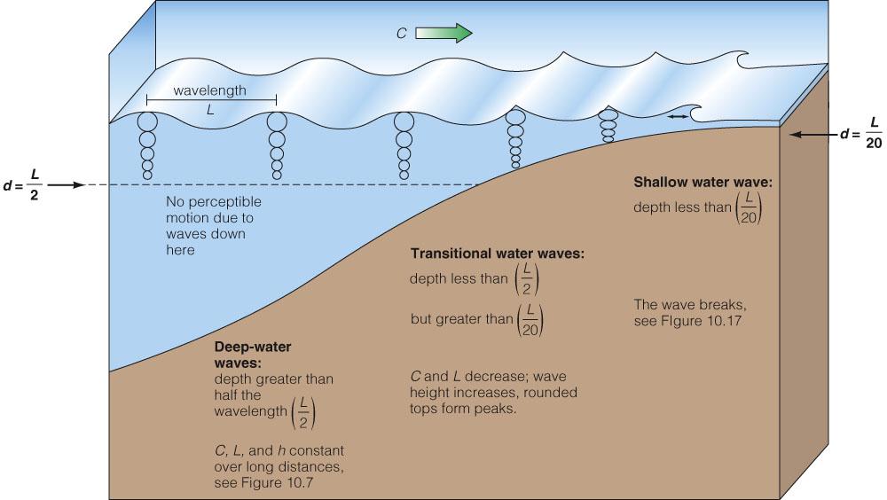
Wave Behavior Is Influenced by Water Depth
Classification of waves depends on their wavelength relative to the water depth.

Slide 15
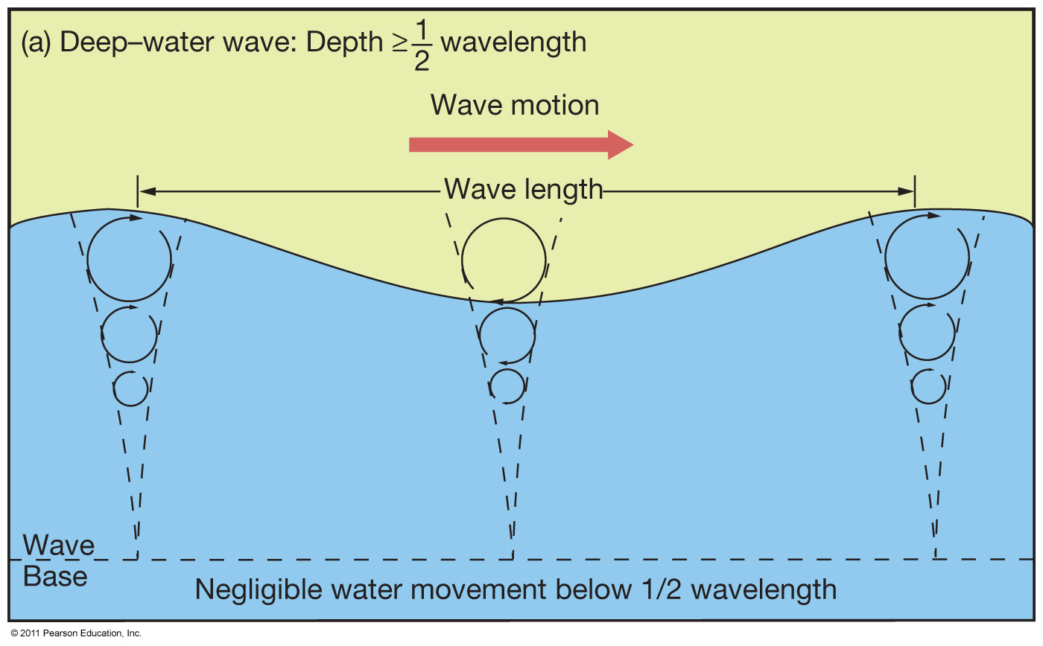
Deep-Water Waves
Water depth is greater than wave base (>½L)

Slide 16
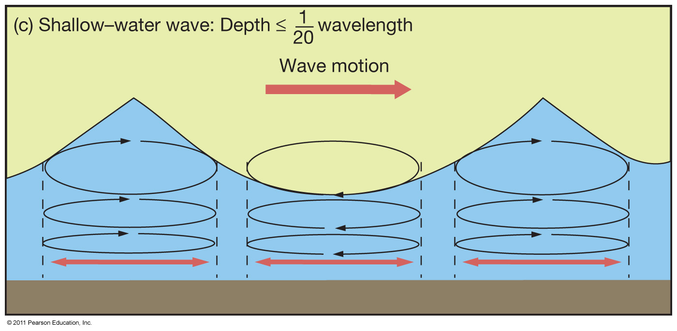
Shallow-Water Waves
Water depth is < ½0L

Slide 17
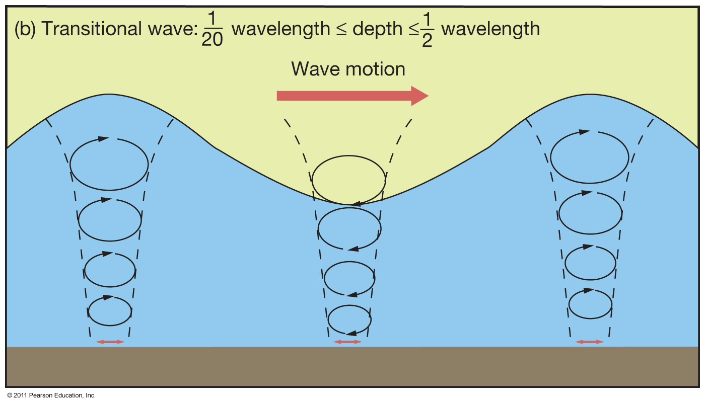
Transitional Waves
Characteristics of both deep- and shallow-water waves

Slide 18
What are the three factors that affect the growth of a wind wave?
Wind speed (must be faster than the wave crests to transfer energy)
Wind duration (more time means bigger waves)
Fetch (the surface area over which the wind blows)
Wind is a disturbing force - it causes waves.
Gravity is a restoring force - it calms large waves.

Slide 19
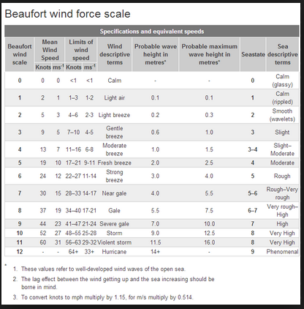
Beaufort Wind Scale on Sea Conditions

Slide 20
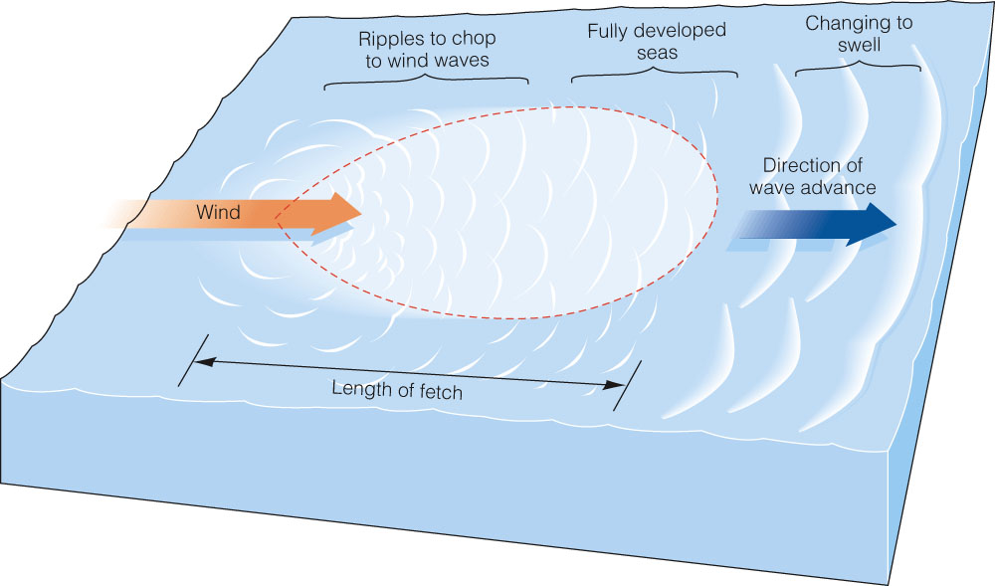
Many Factors Influence Wind Wave Development
The fetch is the uninterrupted distance over which the wind blows without significant change in direction. Wave size increases with increased wind speed, duration, and fetch. A strong wind must blow continuously in one direction for nearly three days for the largest waves to develop fully.

Slide 21
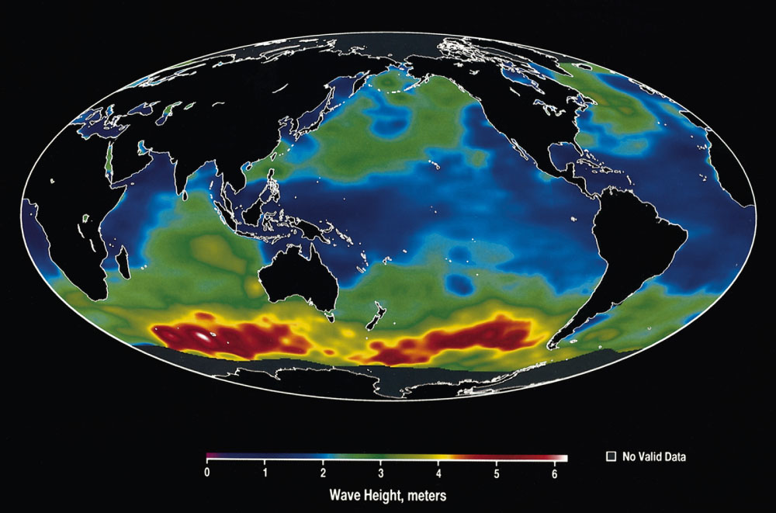
Global Wave Height
Global wave height in October 1992. In this image, the highest waves occur in the southern ocean, where waves were more than 6 meters (19.8 feet) high (represented in white). The lowest waves (indicated by dark blue) are found in the tropical and subtropical ocean, where wind speed is lowest.

Slide 22
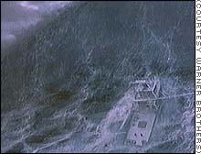

The Andrea Gail
The Andrea Gail climbs an enormous wave in the movie version of "The Perfect Storm." Mid-ocean waves in the actual storm of 1991 were measured at up to 100 feet

Slide 23
WAVES APPROACHING SHORE
As a deep-water wave becomes a shallow-water wave:
  Wave speed decreases
  Wavelength decreases
  Wave height increases
  Wave steepness (height/wavelength) increases
  When steepness > ¹/₇, wave breaks

Slide 24
Wave Movement
When a wave breaks against the shore, the crest outruns the trough and the crest collapses.
Called a breaker.
In this case, water does move forward and backward.

Slide 25
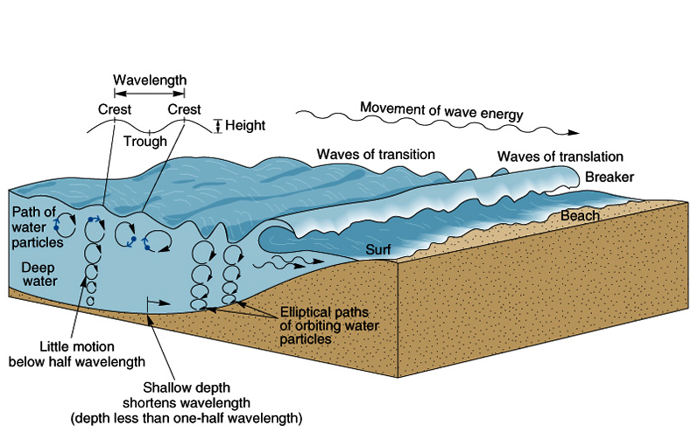
Shore breakers (surf) are collapsing waves.
Breaking is determined by wave steepness.

Slide 26
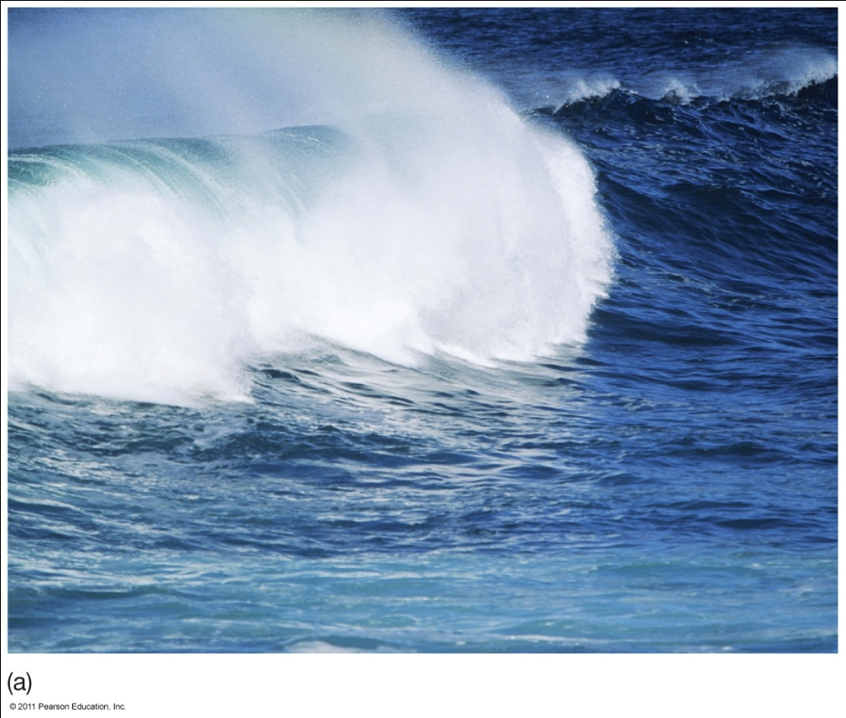
THREE TYPES OF BREAKERS
Spilling Breakers
Gently sloping sea floor
Wave energy expended over longer distance
Water slides down front slope of wave

Slide 27
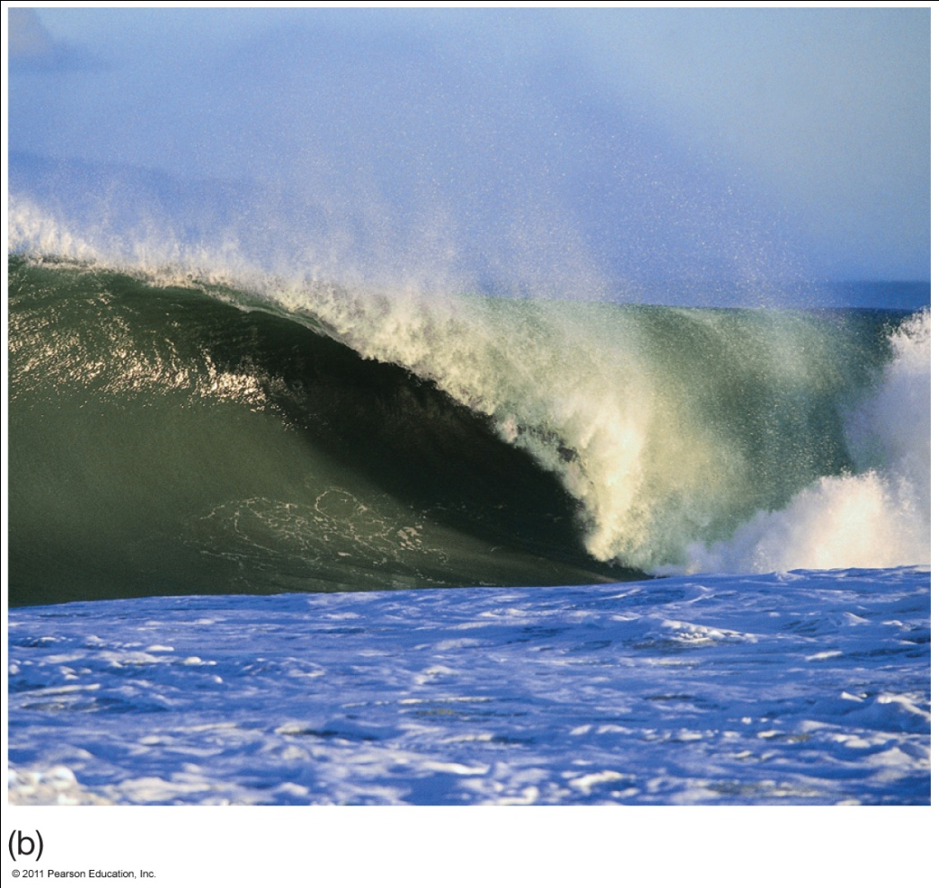
Plunging Breakers
Moderately steep sea floor
Wave energy expended over shorter distance
Best for board surfers
Curling wave crest

Slide 28
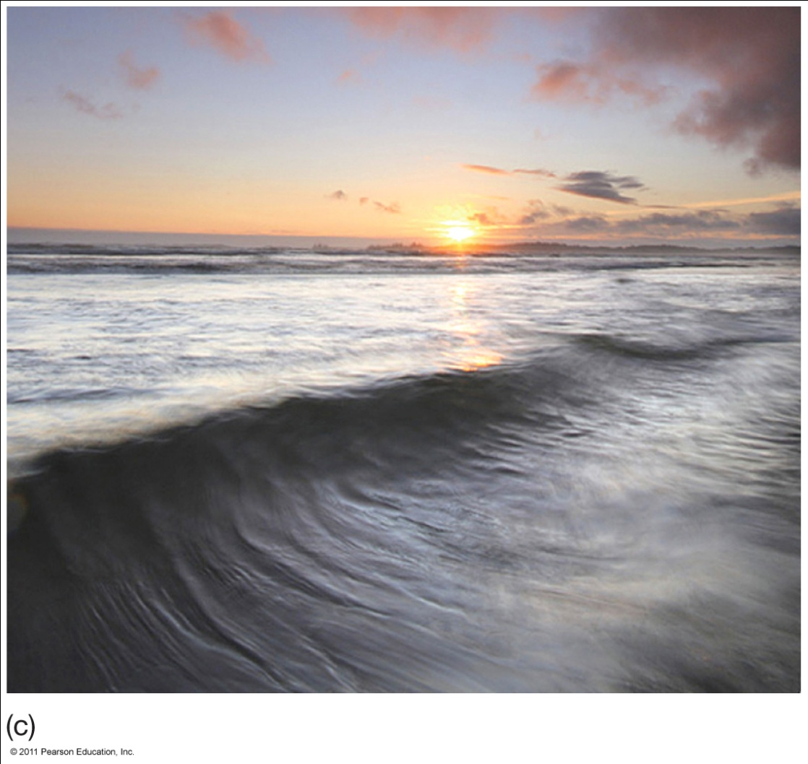
Surging Breakers
Steepest sea floor
Energy spread over shortest distance
Waves break on the shore

Slide 29
Waves Refract When They Approach a Shore at an Angle
Wave refraction - the slowing and bending of waves in shallow water.
Wave diffraction - propagation of a wave around an obstacle
Wave reflection - occurs when waves “bounce back” from an obstacle they encounter. Reflected waves can cause interference with oncoming waves, creating standing waves (aka seiche).

Slide 30
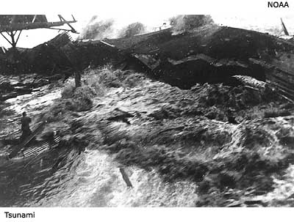
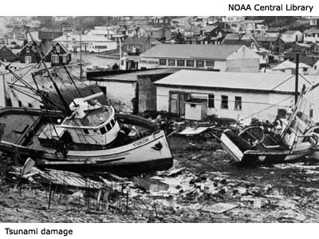
Tsunami and Seismic Sea Waves Are Caused by Water Displacement
Tsunami are long-wavelength, shallow-water, progressive waves caused by the displacement of ocean water. Tsunami caused by the vertical movement of earth along faults are a.k.a. seismic waves.
Other causes:
  Landslides
  Icebergs falling from glaciers
  Volcanic eruptions
  Asteroid impacts

Slide 31
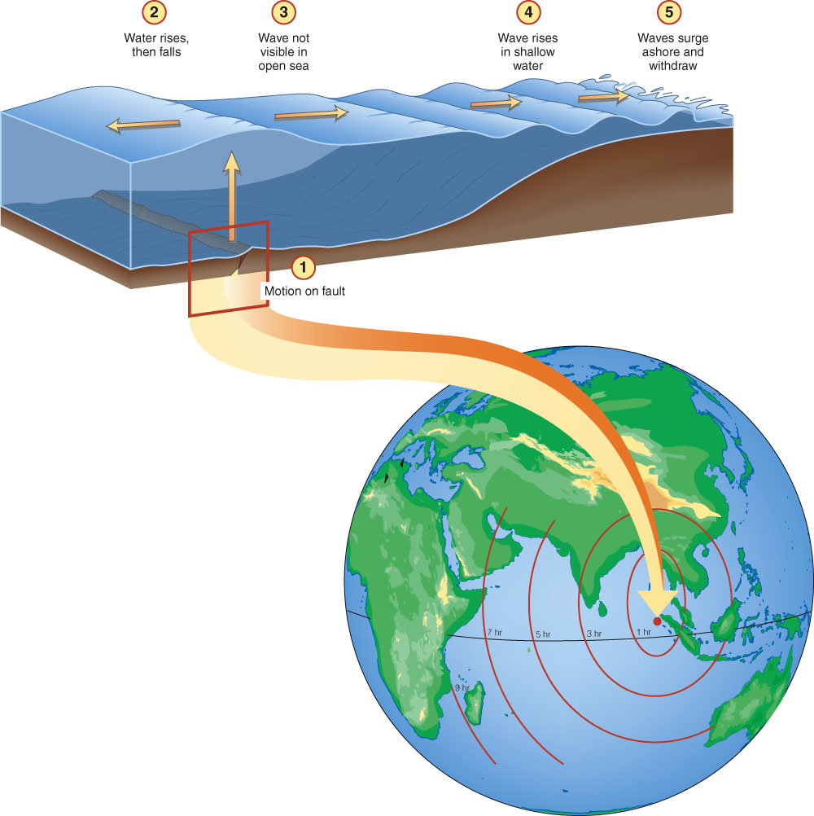
Tsunami Are Always Shallow-Water Waves
Seismic sea waves can reach tremendous size, causing destruction and loss of life.
(right) The great Indian Ocean tsunami of 26 December 2004 began when a rupture along a plate junction lifted the sea surface above. The wave moved outward at speeds of 212 meters per second (472 miles per hour).
At this speed, it took only about 15 minutes to reach the nearest Sumatran coast and 28 minutes to travel to the city of Banda Ache.

Slide 32
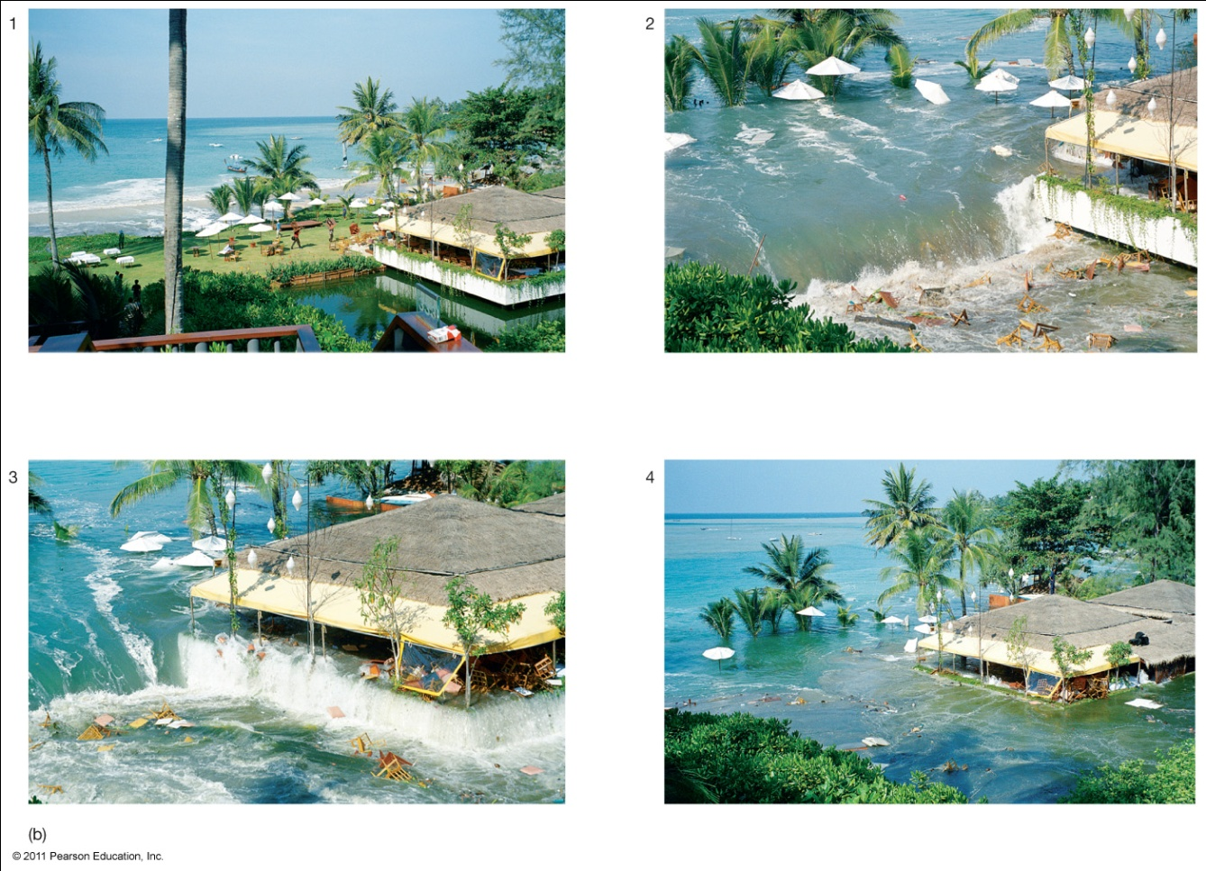
TSUNAMI DESTRUCTION
Sea level can rise up to 40 meters (131 feet) when a tsunami reaches shore.

Slide 33
Storm Surges form beneath Strong Cyclonic Storms
A storm surge is an abrupt bulge of water driven on shore by a tropical cyclone or a frontal storm.
Storm surges are short-lived.
Storm surges consist of only a crest, so they cannot be assigned a period or wavelength, and cannot be called a wave.

Slide 34
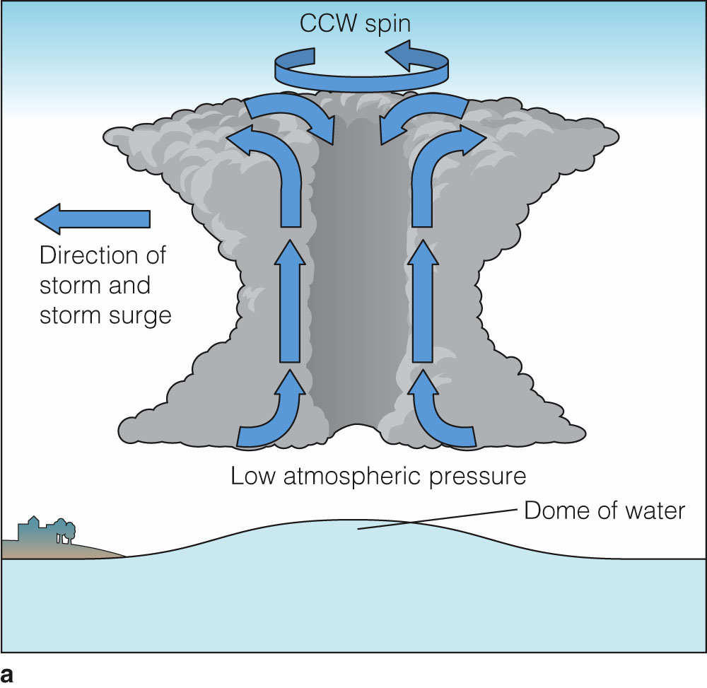
Storm Surges Form beneath Strong Cyclonic Storms
A storm surge.
(a) The low pressure and high winds generated within a hurricane can produce a storm surge up to 9 meters (30 feet) high.

